Slide 1
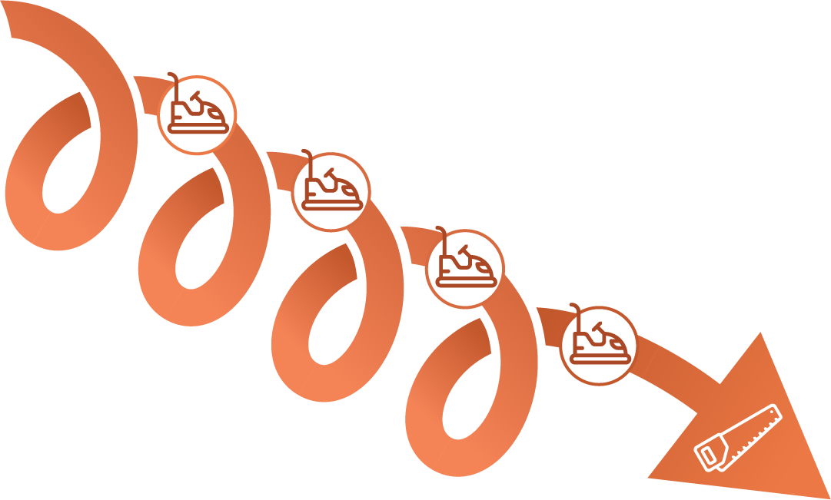
The Unconscious Wounded Career Path & Conscious Healing Career Path Overview
THE CONSCIOUS HEALING CAREER PATH
HEALTHY
EMOTIONS
PAINFUL
EMOTIONS
THE UNCONSCIOUS WOUNDED CAREER PATH
Notes:
Start with this question:
1.. Have you ever felt like you weren’t good enough?
Not worthy?
Not smart enough?
Small?
At one time in my life, I’ve felt all of those things.
I’d like to tell you a story and give you some tools tht will help you get out of this cycle.
[start strong and leave unforgettable)

Slide 2
There are 2 ways to handle workplace conflict (aka Bumper Car Moments)

Slide 3
In this Overview, You Will:
Learn about the Unconscious Wounded Career Path & the Conscious Healing Career Path
See how easy it is to stay stuck in unconscious wounded thinking when in the middle of a Bumper Car Moment
Begin to see that it is possible to handle workplace conflict in new positive ways

Slide 4
When we are stuck on the Unconscious Wounded Career Path, when emotionally triggered in a Bumper Car Moment, we repeat outdated scripts and behaviors
Physiological response: Fight, Flight, Freeze, Fawn
Nervous system response: Hyper- or Hypo-arousal
Old beliefs about ourselves are activated
Fears pop up, fueling our nervous system
Interpretation of what’s happening is fueled by moments in our pasts
We respond in familiar ways –some as people pleasers/perfectionists, others as the bullies. Some try and stay off the radar, while others use flight to run away (resign and look for a new job)
This cycle is engrained in our central nervous systems from when we were young
4
Notes:
We have a physiological response: Fight, Flight, Freeze, Fawn
Our nervous system responds in either a state of hyper arousal (tension, anxiety, defensiveness, addictions, etc) or in a state of hypoarousal (unable to think, depressed, withdrawn, etc.)
Old beliefs about ourselves are activated – I’m not good enough, I don’t deserve good things
Fears pop up fueling our nervous system
Our interpretation of what’s happening is fueled by moments in our pasts
Whenever we are having an over-the-top reaction to a Bumper Car Moment, it is always fueled by a past event or events
We respond in familiar ways – me as the people pleaser/perfectionist, others as the bullies

Slide 5
THIS IS CALLED THE UNCONSCIOUS WOUNDED CAREER PATH
Painful
Emotions
Notes:
Let me give you and example
The Unconscious Wounded Career Path (1 minute story)
Colleague Felt disrespected
Had a strong negative emotional reaction and began and started showing his anger
Others were upset
On the UCWCP and spiraling down
Ready to quit the company and look elsewhere
Did not feel valued
How much time each day do you spend on the UWCP?
How much do you make per hour?
Calculate time spent on the UCWCP
If you are a people manager – how much time are your team members showing up on the UCWCP? What is the cost to your team and their performance?
STRESS/ANXIETY/WORRY COSTS
Interpretations of in-the-moment workplace situations that are unconsciously and negatively influenced by the past - old triggers (I feel judged/criticized/small, etc.), underlying negative limiting beliefs (“I’m not good enough”, “I am stupid”, etc.) and old scripts for responding including people pleasing, perfectionism, bullying, being invisible, etc.
The result of these unconscious interpretations leads to over emotional reactions affecting the quality of resulting decisions and choices/actions. When this happens, leaders’ pasts are influencing the present-day situation in dysfunctional ways.
These are less than desired variables affecting the quality of decision making, the impact on teams, bosses, colleagues, and company culture (increasing toxic workplaces).
Misinterpreting the intent of colleagues, often in moments of workplace conflict (aka Bumper Car Moments), resulting in strained and even damaged relationships at work
Tensions with other business/function leaders fueling siloed mentality and “us vs them” thinking taking the eye off the external competitors and customers to becoming fixated on the internal competitors
Important and needed relationships ruined
Teams feeling the weight of their bosses’ dysfunctional behavior affecting their overall engagement and retention
Team performance not optimized
Lack of trust in colleagues/coworkers
Lack of understanding/belief in own intrinsic value to any community (in this case, workplace groups and teams)
Repeated experiences of being targeted and victimized by bullies
Repeated experiences of being underestimated, undervalued, underemployed
Career stalls
Being fired
Lost income
Toxic workplaces
Personal Costs:
Regularly feel like a failure
Lack of confidence in abilities to effectively deal with coworkers in uncomfortable conflicts
Lack of faith in own judgment
Heightened levels of anxiety, worry and stress
Personalizing when things go wrong
Beating oneself up at night for just about everything
Sense of intense hypervigilance all the time – can never relax
Health related problems
Unhealthy habits to self-comfort (addictions such as alcohol, drugs, overeating, over shopping, etc.)
Shame that comes from the results of unhealthy habits that were installed to help them self-soothe.
Confusion
Depression
Exhaustion
Loneliness/isolation
Workaholism with limited worklife balance and missed time away to refresh and regenerate
Distant relationship with loved ones (children and partners)
A deep sense of career suffering affecting all aspects of one’s life
Failed marriages
Frustrated in knowing that he/she deserves a better experience of life and more potential, but self-belief gets in the way.

Slide 6
When we intentionally step onto the Conscious Healing Career Path and get emotionally triggered in a Bumper Car Moment, we can choose to respond differently:
Physiological response to a Bumper Car Moment happens: We still feel Fight, Flight, Freeze, Fawn
Nervous system response: We learn how to quickly change our state from our sympathetic to our para-sympathetic nervous system
Old beliefs about ourselves are activated
Interpretation of what’s happening is fueled by the current day situation, not fueled from past experiences
We respond in new, healthy ways –coming from our highest functioning adult selves aware that our past does not dictate our current day interpretations of others’ behavior
We can break the old cycle of responding to workplace conflict unconsciously
6

Slide 7
HEALTHY
EMOTIONS
THIS IS THE CONSCIOUS HEALING CAREER PATH
Notes:
The Conscious Healing Career Path
Story of colleague who decided to elevate his actions, consider how the past was fueling his anger
Aplogized to co-workers
CHCP questions:
Asking - Are you sure? Is there another possible explanation?
Was there a time in your past when you feel disrespected?
Is it possible that this instance is being fueled by the past incident?
Helped him to reframe the current workplace issue
Reclaim his power by creating a different interpretation of the events
Hired a coach to work with him
POSITIVE OUTCOMES:
Professional Benefits:
Ability to make more conscious and present moment interpretations, especially in moments of workplace conflict, resulting in healthier decisions, choices, and actions (which frankly is good for everyone)
Ability to demonstrate healthier, less triggered reactions to workplace conflict (Bumper Car Moments)
Healthier and more engaging cultures (toxicity factor goes down)
Improved relationships with bosses and colleagues
Enhanced and more optimized performance of the teams we lead
Better equipped to role model worklife integration for others
More aware of professional development areas needing attention, with clarity on what to do differently
Able to recognize/celebrate personal and team members’ accomplishments
Personal Benefits:
Healthier reactions to workplace stress resulting in less beating oneself up at the end of the day and over the weekend
Career clarity of knowing what to do differently to be even more effective
Improved confidence
More rested and energized
From inner critic to inner coach
From Unconscious Wounded Career Path to Conscious Healing Career Path
From stress, anxiety and worry (SAW) to Rapid Power Reclaim (Your very own Swiss Army Knife)
From inner child to inner adult
From past reality to present professional reality
Better worklife integration and balance
Reconnecting and deepening relationship with loved ones
Healthier habits for managing stress
Improved relationship with self
Enhanced joy and self-acceptance in everything one does – even the challenging interactions one might have at work.

Slide 8
We Always Have a Choice
HEALTHY
EMOTIONS
THE CONSCIOUS HEALING CAREER PATH
THE UNCONSCIOUS WOUNDED CAREER PATH
PAINFUL
EMOTIONS
Notes:
Which one do you want to be on?

Slide 9
“We can change the character of our life by changing our beliefs” Dr. Bruce Lipton
9

Slide 10
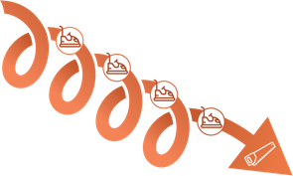
Every Bumper Car Moment can be viewed through either the:
UNCONSCIOUS WOUNDED CAREER PATH THINKING or CONSCIOUS HEALING CAREER PATH THINKING
10

Slide 11
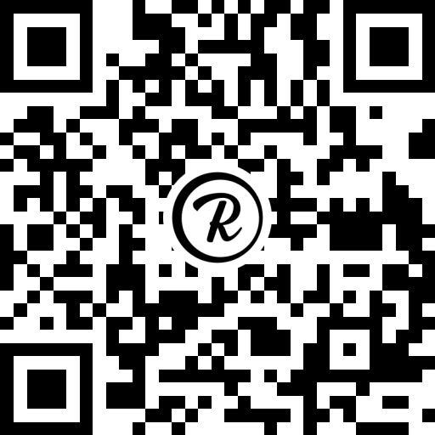
Bumper Car Mini Course
For more information about the Unconscious Wounded Career Path and the Conscious Healing Career Path
Check out the
Bumper Car Moments Mini Course
ON SALE $29
$99
Notes:
https://programs.healingatwork.com/bumper-car-mini-course-training

